Slide 1
Hertz Global Holdings, Inc.
Chapter 11 Restructuring Analysis
Date- December 2025
Confidential – For illustrative and educational purposes only

Slide 2
Situation Overview
Item | Detail
Filing Date | May 22,2020
Industry | Vehicle Rental
Trigger | CoVID-19 travel collapse
2019 Revenue | $9. bn
2020 Revenue | $5.2 bn (-47%)
2019 EBITDA | $2.3 bn
2020 EBITDA | $(0.5)bn
Total Debt | $19.2 bn
Liquidity Run-Out | 2021 (pre-restructuring)
Demand shock + leverage rendered capital structure unsustainable
Liquidity exhaustion forced Chapter 11 filing
Source: Company filings, public disclosures

Slide 3
Business Overview
Metrics | Value
Brands | Hertz, Dollar, Thrifty
Geography | Global airport & off- airport
Business Model | Asset- backed vehicle rental
Customers | Leisure & business travel
Globally recognized brand portfolio
Large, flexible vehicle fleet
High operating leverage to travel demand
Going-concern value exceeds liquidation value
Source: Company disclosures

Slide 4
Causes of Disaster
Factor | Impact
Travel collapse | Revenue 47% in 2020
Fixed Costs | Fleet + operating rigidity
Leverage | 8.3 x Debt / EBITDA
Interest Burden | $900mm annual cash interest
Liquidity | $(1.46) bn FCF in 2020
Based on pre-petition operating forecasts

Slide 5
Capital Structure at Filing
Tranche | Amount ($bn) | Priority
Vehicle ABS Debt | 14.0 | Secured
First Lien Term Loan | 1.4 | Secured
Second Lien Notes | 0.4 | Secured
Senior Unsecured Notes | 2.8 | Unsecured
Convertible Notes | 0.6 | Unsecured
Total Debt | 19.2
Secured ABS debt structurally senior to corporate creditors.
Footnote ABS debt secured by vehicle fleet

Slide 6
Enterprise Valuation
Case | EBITDA($bn) | Multiple | EV($bn)
Low | 1.2 | 4.0 x | 4.8
Base | 1.5 | 4.5 x | 6.75
High | 1.8 | 5.0 x | 9.0
Valuation performed for recovery analysis purposes only and does not represent market trading or intrinsic equity value.
Valuation anchored to distressed transportation comps
Footnote: Valuation for recovery analysis only

Slide 7
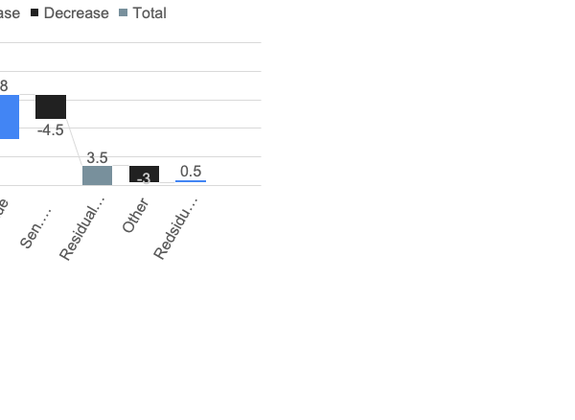
Waterfall Analysis
Class | Claim($bn) | Recovery($bn) | %
ABS Lenders | 14 | 14 | 100%
First Lien | 1.4 | 1.4 | 100%
Second Lien | 0.4 | 0.4 | 50%
Senior Unsecured | 2.8 | 1.15 | 41%
Convertible | 0.6 | 0.0 | 0%
Equity | - | 0.0 | 0%
Translates enterprise value into dollar recoveries for each class of debt and equity, identifying who is in-the-money and who is impaired.
Recoveries based on base-case enterprise value

Slide 8
Restructuring
Action | Outcome
Reinstated ABS debt | Preserves fleet financing
Extend First Lien | Liquidity relief
Partial 2L conversion | Deleveraging
Unsecured equalization | Balance-sheet repair
Equity cancellation | Reflects insolvency
Illustrative restructuring mechanics.

Slide 9
Pro Forma Capital Structure
Instrument (Post- reorg capitalization) | Balance ($bn)
Vehicle ABS | 14
First Lien | 1.4
Second Lien | 0.2
Total debt | 15.6
Metric | Value
Debt / EBITDA | 10.4 x
Cash Interest/ EBITDA | 55%
Demonstrates that Hertz emerges from Chapter 11 with sustainable leverage, liquidity, and a viable long-term balance sheet
Based on 2022E EBITDA

Slide 10
Recovery Analysis
EV ($bn) | Recovery %
5.0 | 20%
6.75 | 41%
8.5 | 60%
Recoveries highly sensitive to valuation.
Footnote: Assumes constant claim priorities.

Slide 11
Risks
Slower travel recovery
Used vehicle price volatility
Fleet financing availability
High operating leverage
Restructuring execution risk
Risks illustrative, not exhaustive

Slide 12
Recommendations
Proceed with balance-sheet restructuring
Preserve going-concern value vs liquidation
Equitize unsecured debt to reduce leverage
Raise new equity to support liquidity & fleet renewal
Subject to court approval and creditor negotiations

